Slide 1

RUBY
Jess Wyman
Notes:
https://www.google.com/url?sa=i&url=http%3A%2F%2Fclipart-library.com%2Fruby-cliparts.html&psig=AOvVaw1PfwYEo5_ix7puY2v_8Eie&ust=1616432093965000&source=images&cd=vfe&ved=0CAIQjRxqFwoTCOCHsPjswe8CFQAAAAAdAAAAABAD

Slide 2

Language Development
Developed by Yukihiro Matsumoto
Wanted an easy-to-use object oriented scripting language
“Natural, not simple”
Used other languages as a guide
Balancing functional programming with imperative programming
Multi-paradigm
Principle of least astonishment

Slide 3
History
1993: Ruby was born
1995: First public version
1998: First homepage
1999: First book on the language
2005: Ruby on Rails
2008: Ruby reached its peak

Slide 4




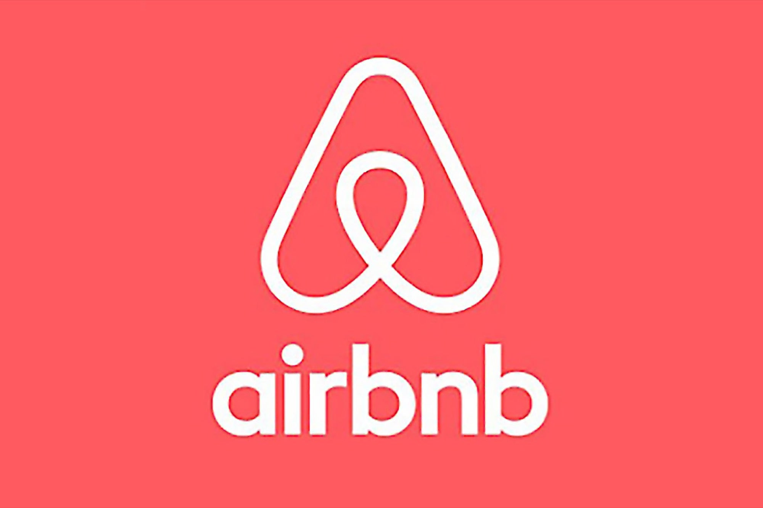


Companies and Websites Using Ruby / Ruby on Rails
Github
Air BnB
Soundcloud
Groupon
Kickstarter
Shopify
Urban Dictionary

Slide 5
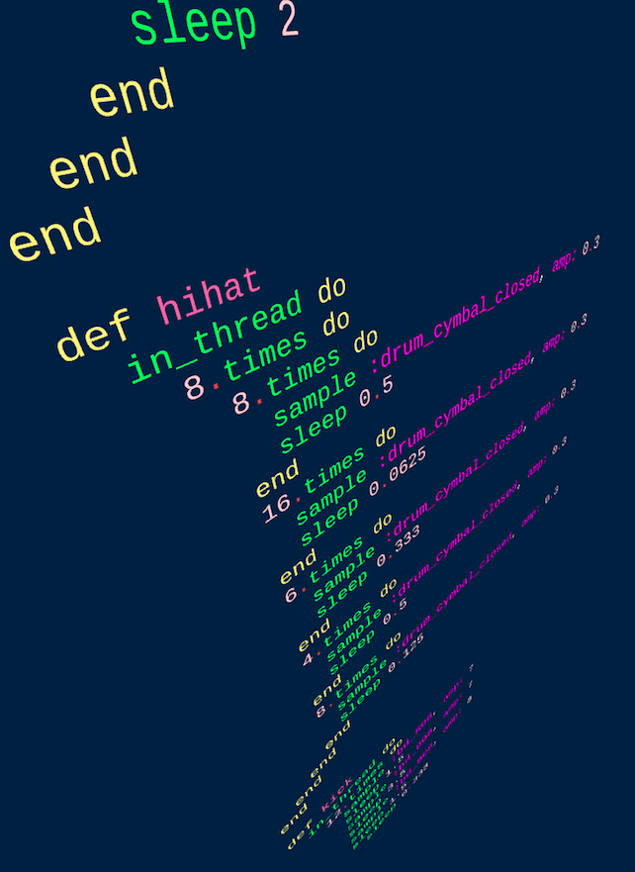
Language Design
The creator wanted an object oriented programming language that was easy and natural to use
He accomplished this by emphasize human needs and readability
Multi-paradigm programming language
Can supports procedural, functional, and object oriented programming.
Notes:
Because he focused on readability, he didn't focus the language running quickly on the computer.

Slide 6
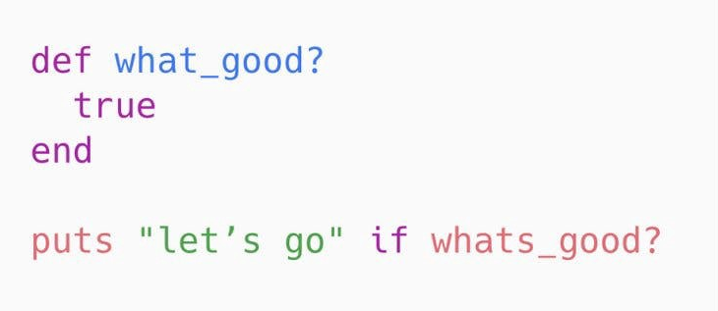
Basic Syntax
Similar to Python
Line breaks and semicolons can be used to represent the end of a statement
Indentation is not meaningful
Instance variables are completely private in the class
Everything is an object
Use puts to print on a new line

Slide 7
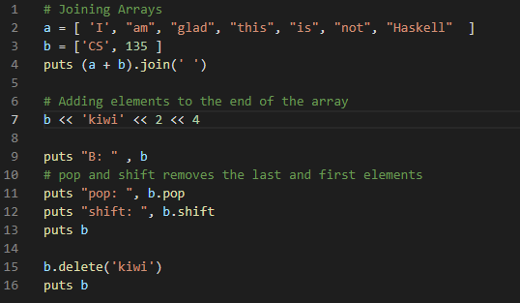
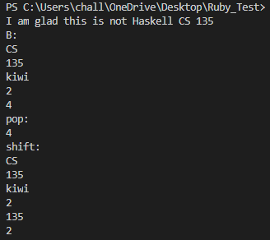
Array Example
Example Code
Output

Slide 8
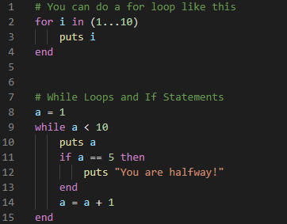
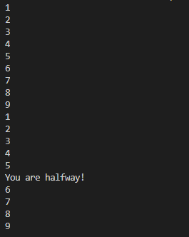
Loops Example
Example Code
Output

Slide 9
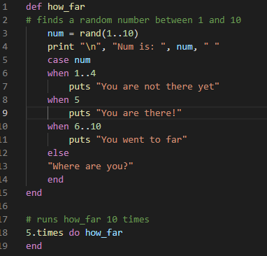
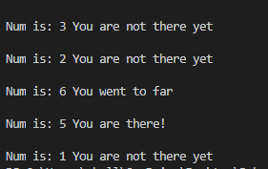
Case Statements Example
Example Code
Output

Slide 10
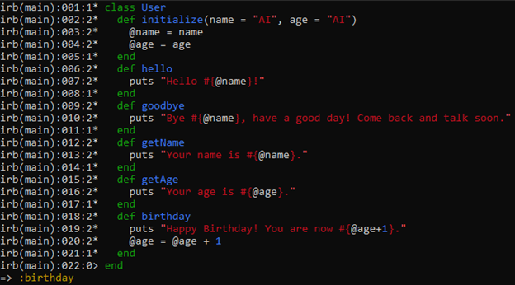
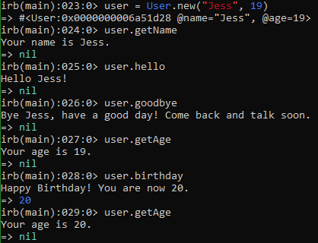
Classes and Objects Example
Example Code
Output

Slide 11
Works Cited
https://www.sitepoint.com/history-ruby/
https://rubygarage.org/blog/history-of-ruby-on-rails-vs-symfony-2#:~:text=Appearing%20in%201995%2C%20Ruby%20was,human%20needs%20above%20computer%20needs.
https://www.ruby-lang.org/en/about/
https://en.wikipedia.org/wiki/Ruby_(programming_language)#Early_concept
https://www.studytonight.com/ruby/introduction-to-ruby
https://www.google.com/url?sa=i&url=https%3A%2F%2Fwww.entrepreneur.com%2Farticle%2F235709&psig=AOvVaw2lTi117MCjFJ41fQrzQ7ln&ust=1616595779947000&source=images&cd=vfe&ved=0CAIQjRxqFwoTCLiOm97Oxu8CFQAAAAAdAAAAABAO

